Slide 1
Log4j
Session 1

Slide 2
Objectives
Log4j Introduction
Log4j Advantages and Disadvantages
Log4j Installation
Log4j Methods

Slide 3
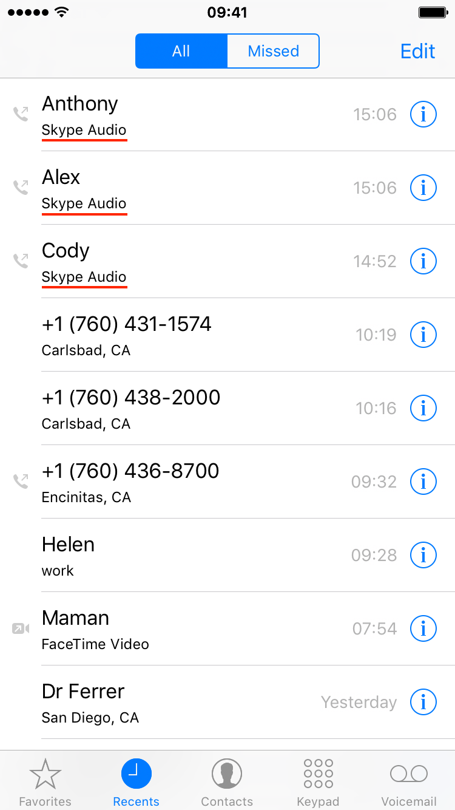
Introduction to Log4j
Analogy
Consider simple example of your smartphones
When I am saying let me see your call log that time call log will keep all information about all kind of incoming and outgoing call.
This log is also updating if new call will be done so this is nothing but log keeping of your calls.

Slide 4
Introduction to Log4j
Process of keeping log is Logging
In simple word we can say the logging means some way to indicate the state of the system at runtime.
Good logging requires three things:
Logging should provides what our application is doing internally
Logging process should not be very heavy, it would be very efficient so it couldn’t affect performance of your system.
You need to be able to adapt the logging details to different deployment environments and situations

Slide 5
Introduction to Log4j
Advantages of Logging
Quick Debugging: If we write logging code very well then we will be able to find root cause of that respective application and we can fix it quickly.
Problem Diagnosis: No matter how well written our code is, there may be some problems hidden in it. If you review the logging process, then we will be able to detect the problems precisely and quickly.
Easy Maintenance: If application is properly logged then it is very easy to debug which results easy for maintenance.
Cost and Time Savings: Well-written logging code offers quick debugging and easy maintenance. It makes installation, day to day maintenance, and maintenance, and debugging much more cost and time-effective.

Slide 6
Introduction to Log4j
Disadvantages of Logging
Following disadvantages can occur with any logging process:
Logging adds runtime overhead due to the generation of logging information and the device Input/Output (I/O) related to publishing logging information.
Logging includes programming overhead due to the extra code required for producing logging information. The logging process increases the size of the code.
Badly produced logging information can cause confusion.
Logging with bad code can seriously affect the application's performance.

Slide 7
Introduction to Log4j
Why use Log4j?
Log4j is open source.
Log4j facilitate us to store flow details either in file or database.
Log4j is worked for large as well as small projects.

Slide 8
Introduction to Log4j
Log4J Features
It is thread-safe
It is optimized for speed
It is based on a named logger hierarchy
It supports internationalization
It supports multiple outputs of appenders per logger
It is not restricted to a predefined set of facilities
The format of the log output can be easily altered by extending the Layout class
It is designed to manage Java exceptions from the start
Behavior of logging can be set at runtime using a configuration file

Slide 9
Introduction to Log4j
Log4J Features
It is thread-safe
It is optimized for speed
It is based on a named logger hierarchy
It supports internationalization
It supports multiple outputs of appenders per logger
It is not restricted to a predefined set of facilities
The format of the log output can be easily altered by extending the Layout class
It is designed to manage Java exceptions from the start
Behavior of logging can be set at runtime using a configuration file

Slide 10
Log4j Architecture
Log4j follows a layered architecture where each layer is used to provide different objects to perform different tasks. This layered architecture makes the design easy and flexible to extend in the future.
There are two types of objects available in the log4j framework:
Core objects: Core objects are mandatory objects of the framework. All objects are required to use the framework.
Support Objects: Support objects are optional objects of the framework. They used to support core objects to perform additional but important tasks.

Slide 11
Log4j Architecture
Core Objects
Logger:
The Logger is the top-level layer which provides the Logger object. The Logger object is responsible for taking logging information, and they are stored in a namespace hierarchy.
Logger is a class, which is available in org.apache.log4j.*
We have to create Logger object one per java class
Logger component is used to enable the log4j in our java class
Logger methods are used to generate log statements in a java class instead of SOPLS.
In order to get an object of Logger class, we need to call a static factory method which will give an object as a return type
We have to create a Logger object right after our class name. For example:

Slide 12
Log4j Architecture
Getting logger object:
static Logger log = Logger.getLogger(YourClassName.class.getName())
Logger object has some methods; these methods are used to print the status of our application:
These methods are:
debug() ->The DEBUG Level designates fine-grained informational events that are most useful to debug an application.
info() → general tips, news information, it will display the information.
warn() ->can be seen as a warning the warning, in general we need to optimize the code.
error() -> you can think of error error here only to show the red error message, these errors we need careful analysis.
fatal() ->The FATAL level designates very severe error events that will presumably lead the application to abort.
(Note - These all methods are approximately the same. Priority order of these methods is: debug < info < warn < error < fatal.)

Slide 13
Log4j Architecture
Next Object is →
Appender:
The appender is the lower layer component, which provides Appender objects. The Appender object is responsible for publishing logging information to various preferred destinations such as a file, database, console, Unix Syslog, etc.
Logger classes are used to generate statements in different levels, and Appender takes these logs and stores in some database or files.
Appender is not a class; it is an interface.
In log4j, we have different Appender implementation classes:
FileAppender: used to append log events to a file. It supports two more appender classes:
RollingFileAppender: Extends FileAppender class to back up the log files when they reach a certain size.
DailyRollingFileAppender: Extends FileAppender class so that the underlying file is rolled over at a user-chosen frequency.

Slide 14
Log4j Architecture
Next Object is →
Appender:
ConsoleAppender: Appends log events to System.err or System.out using a layout specified by the user. The default console is System.out.
JDBCAppender: Used for Database.
SMTPAppender: Used to send an email when a specific logging event occurs, typically on errors or fatal errors.
SocketAppender: Used for remote storage.
SyslogAppender: Sends messages to a remote Syslog domain.
TelnetAppender: Specializes in writing to a read-only socket.
WriterAppender: Used to append log events to a Writer or an OutputStream depending on the user's choice.

Slide 15
Log4j Architecture
Next Object is →
Appender:
ConsoleAppender: Appends log events to System.err or System.out using a layout specified by the user. The default console is System.out.
JDBCAppender: Used for Database.
SMTPAppender: Used to send an email when a specific logging event occurs, typically on errors or fatal errors.
SocketAppender: Used for remote storage.
SyslogAppender: Sends messages to a remote Syslog domain.
TelnetAppender: Specializes in writing to a read-only socket.
WriterAppender: Used to append log events to a Writer or an OutputStream depending on the user's choice.

Slide 16
Log4j Architecture
Next Object is →
Layout:
The layout layer provides Layout objects which are used to format logging information in different styles. It is used to provide support to appender objects before publishing logging information.
Layout objects play an important role in publishing logging information in a way, i.e., human-readable and reusable.
The layout component defines the format in which the log statements are written into the destination repository by the appender.
There are different types of layout classes in log4j:
SimpleLayout: It is used to format the output in a very simple manner; it prints the Level, then a dash "-" and then the log message.
PatternLayout: Used to format the output based on conversion pattern specified or if none is specified, the default conversion pattern is considered.
HTMLLayout: It formats the output as an HTML table.

Slide 17
Log4j Architecture
Note → Log4j is a defacto standard logging library for Java.
Java.util.logging is a built in logging mechanism in Java, but that doesn't make it the greatest Use Log4j

Slide 18
Installation of Log4j
For working with Log4j we will required log4j jar files which we will have to download from official web site of Apache.
We will have to follow steps to add it in our project
Step 1. go to Build path
Step 2. go configure build path
Step 3. click on classpath
Step 4. click on Add external jar
Step 4. Select from desired destination

